Slide 1
https://github.com/marianosz/netCoreWorkshop
Notes:
No better time to be a .NET developer – you have more scenarios at your finger tips than ever, using the technology you love and make you productive. You can literally build any app for any device for any platform with .NET.

Slide 2
.NET Core Workshop
Mariano Sánchez
sanchezmariano@outlook.com @marianosz
http://weblogs.asp.net/marianos

Slide 3





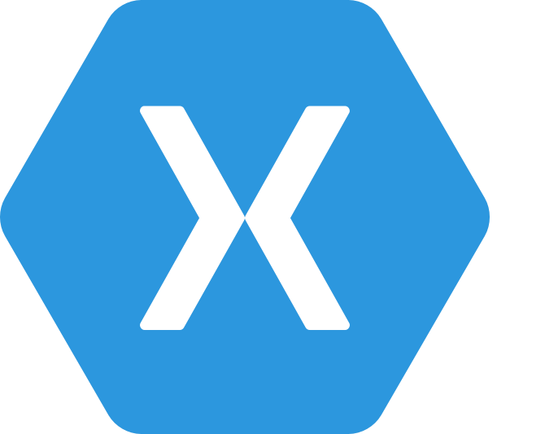
.NET Any developer, any app, any platform
iOS
OS X
Notes:
No better time to be a .NET developer – you have more scenarios at your finger tips than ever, using the technology you love and make you productive. You can literally build any app for any device for any platform with .NET.

Slide 4
Exciting times ahead for .NET
Multi-purpose, comprehensive framework for desktop and web applications
Modern DEVICE EXPERIENCE
Universal Windows platform
Unified development across Windows devices
XAMARIN
Extend your reach to any device with .NET
.NET FRAMEWORK
Modern CLOUD EXPERIENCE
.NET CORE
Cross-platform, high performance .NET
ASP.NET Core
Cloud optimized framework for micro services

Slide 5
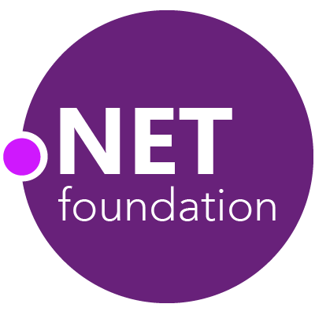



.NET Compiler Platform ("Roslyn")
MVVM Light Toolkit
MSBuild
ASP.NET MVC
IdentityManager
ASP.NET Core
MEF
.NET Core
.NET SDK for Hadoop
.NET Micro Framework
Kudu
Cecil
Mimekit
Mono
Mailkit
Xamarin.Auth
Umbraco
Cake
Open Live Writer
NuGet
WorldWide Telescope
Couchbase Lite for .NET
ASP.NET Web Pages
Microsoft Azure SDK for .NET
ASP.NET SignalR
WCF
Openness
Community
Rapid innovation
LLILC
Xamarin SDK
Entity Framework
Open XML SDK
IdentityServer
Microsoft Azure WebJobs SDK
Microsoft Web Protection Library
OWIN Authentication Middleware
Orchard CMS
ProtoBuild
ASP.NET Web API
System.Drawing
Orleans
ASP.NET AJAX Control Toolkit
Prism
Xamarin.Mobile
Salesforce Toolkits for .NET
Protection
Practices
Visibility
Support
Licenses
Copyrights
Trademarks
Patents
Mentorship
Governance
Feedback
Co-ordination
Media
Branding
Events
Hosting
Code signing
CLA Management
Swag
Notes:
Description (“what is the .NET Foundation”)
The .NET Foundation is an independent organization created to foster open development and collaboration around the growing collection of open source technologies for.NET. It will serve as a forum for commercial and community developers alike with a set of practices and processes that strengthen the future of the .NET ecosystem.
Story telling (“why the .NET Foundation”)
In 2012 we announced how some key components of .NET such as ASP.NET MVC or Entity Framework embraced a new development process that was more transparent, open, and community driven. Since then, Microsoft has received great feedback from you. Increasing our investments in .NET, while opening the process to the community has allowed .NET to innovate faster with feedback and contributions. With the .NET Foundation we want to extend this new development model to be the norm for .NET and not the exception. We want to make sure that .NET projects (both from Microsoft and from other companies and individual contributors) have a place that provides the mechanisms to promote the openness, community participation and rapid innovation to build the next generation of the .NET ecosystem.
Messaging pillars (“what are the top three things I need to know about the .NET Foundation”)
It opens the development process for .NET: The .NET Foundation brings into one common umbrella existing and new relevant open source projects for the .NET platform, such as ASP.NET, Entity Framework and the recently added .NET Compiler Platform (“Roslyn”). The .NET Foundation will provide the frame for making this the norm moving forward, so more and more components and libraries of .NET are using an open process that is transparent and welcomes your participation.
It encourages customers, partners and the broader community to participate: The .NET Foundation will foster the involvement and direct code contributions from the community, both through its board members, advisory council, technical steering group, as well as directly from individual developers, through an open and transparent governance model that strengthens the future of .NET.
It promotes innovation by a vibrant partner ecosystem and open source community: The .NET Foundation will promote commercial partners and open source developers to build solutions that leverage the platform openness to provide additional innovation to .NET developers. This includes extending .NET to other platforms, extending Visual Studio to create new experiences, providing additional tools or extending the framework and libraries with new capabilities.
Call to action: Join the conversation
We are just taking the first steps in the creation of the .NET Foundation because we want your feedback and participation from the very beginning. We are starting with a core set of participants including representatives for the .NET open source community, partners and enterprises such as Miguel de Icaza and Salesforce for example, who will collaborate to define the frame of the .NET Foundation. You can actually be part of that process too by providing feedback at dotnetfoundation.org.

Slide 6
.NET: the family gets bigger
.NET FRAMEWORK
.NET CORE
XAMARIN
Platform for .NET applications on Windows
Cross-platform and open source framework optimized for modern app needs and developer workflows
Cross-platform and open source Mono-based runtime for iOS, OS X, and Android devices
Distributed with Windows
Distributed with app
Distributed with app
Notes:
Notes: Focus on the great additions to the .NET Framework, enabling developers to target the latest applications in the cloud and devices. Explain the distribution mechanism of each. .NET Framework is distributed and available on Windows whereas .NET Core & Xamarin are distributed with the app.

Slide 7
.NET yesterday—app models and libraries
.NET FRAMEWORK
.NET CORE
XAMARIN
APP
MODELS
WPF
Windows Forms
UWP
iOS
Android
ASP.NET
ASP.NET Core
OS X
BASE
LIBRARIES
Base Class Library
Core Library
Mono Class Library
COMMON INFRASTRUCTURE
Compilers
Languages
Runtime components
Notes:
Notes: Even if we are reusing a lot across components (especially with the open sourcing last year), the reality is that each platform has its own implementation of the base libraries.
Note: .NET Framework BCL and Mono BCL are the same APIs, different implementation. .NET Core “Core Library” is a similar set of APIs, but different.

Slide 8
.NET yesterday—reusing code
CHALLENGES
Difficult to reuse skills
Need to master 3+1 base class libraries
Difficult to reuse code
Need to target a small common denominator
Difficult to innovate
Need implementations on each platform
Implementation 3
Implementation 2
Implementation 1

Slide 9
.NET today
.NET FRAMEWORK
.NET CORE
XAMARIN
WPF
Windows Forms
UWP
iOS
Android
ASP.NET
ASP.NET Core
OS X
.NET STANDARD LIBRARY
One library to rule them all
COMMON INFRASTRUCTURE
Compilers
Languages
Runtime components
Notes:
Notes: Please welcome the .NET Standard Library [explain details]
As we move into the future we want to make it much easier for .NET developers to write their code once and be able to execute across .NET implementations, whether that’s .NET Framework, .NET Core, or Mono/Xamarin. To this end, we will continue to evolve and expand the .NET Standard into a set of APIs that are shared broadly across frameworks and application models. This will provide our ecosystem with much more explosive growth with libraries that can shared much more easily.

Slide 10
.NET today—reusing code
BENEFITS
Reuse skills
Master one library, not a platform
Reuse code
Big surface area - no small common denominator
Faster innovation
.NET Standard can grow without updating platforms
Reference implementations
Full implementations
Notes:
Notes: Reusing code is dramatically better with the .NET Standard Library. It includes reference implementations, just like the PCL but it also can be extended with full implementations shared across all platforms.

Slide 11
.NET Standard
.NET Standard is a specification that represents a set of APIs that all .NET platforms have to implement.
This unifies the .NET platforms and prevents future fragmentation.

Slide 12
How is .NET Standard different from .NET Core?
.NET Standard is a specification that covers which APIs a .NET platform has to implement.
.NET Core is a concrete .NET platform and implements the .NET Standard.

Slide 13
.NET Runtimes
Full .NET CLR
Includes all APIS, and ensures backward compatibility.
.NET Core
Small (11 MB)
Composable, distributed via NuGET
Side by Side
Cross-Platform
Windows, OS X, Linux
Ryujit y .NET GC OSS

Slide 14
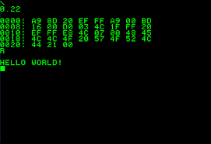



.NET Core

Slide 15
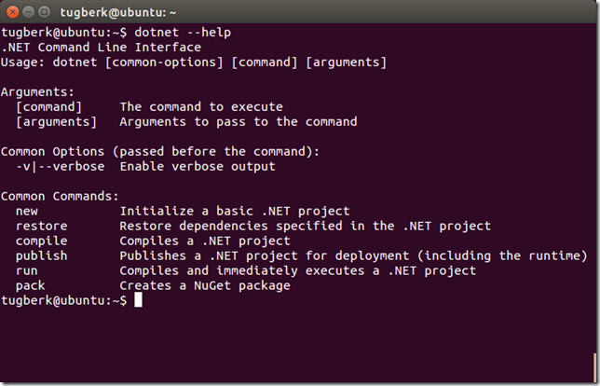
.NET Command Line Interface (CLI)
A single tool for compiling, deploying, and managing .NET applications on all platforms
Notes:
The .NET Execution Environment (DNX) is a software development kit (SDK) and runtime environment that has everything you need to build and run .NET applications for Windows, Mac and Linux. It provides a host process, CLR hosting logic and managed entry point discovery. DNX was built for running cross-platform ASP.NET Web applications, but it can run other types of .NET applications, too, such as cross-platform console apps

Slide 16
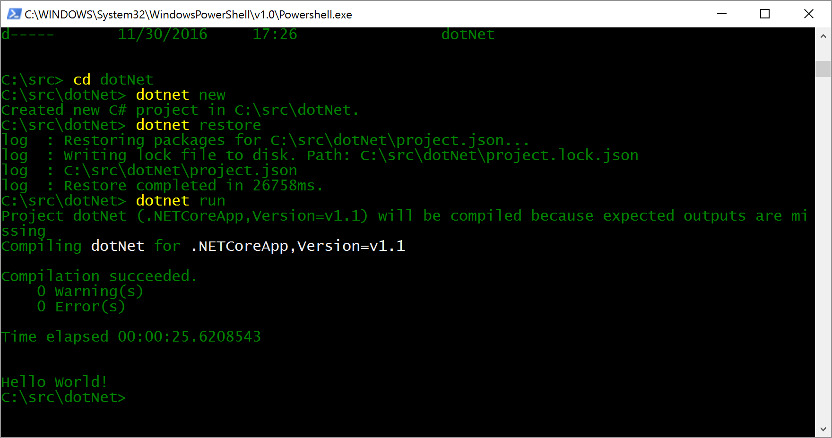
Running a .NET application
dotnet run

Slide 17
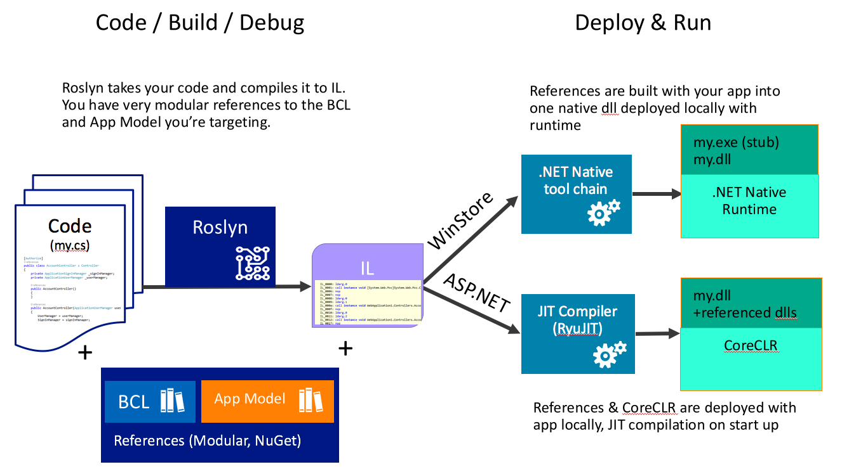

Slide 18
Installing .NET Core
Compiling
https://github.com/dotnet/coreclr
Using Command Line
http://dot.net
Using the installer
http://dot.net

Slide 19
Languages
C#
Flexible, powerful, multi-purpose
Investments in C# 7: Evolve for modern patterns in distributed applications: tuples, pattern matching, others.
VB
Simple, easy to use
Investments in VB 15: Bring key language features and platforms while keeping VB simplicity principles.
F#
Elegant functional programming
Investments in .NET Core: Language updates for C# 7 / VB 15 interop, platform support and tooling updates.
Notes:
C#, Visual Basic and F# are all supported on .NET Core and can be used to create cross-platform apps that run anywhere. In addition, C# is supported in other cross-platform editors like Visual Studio Code via OmniSharp. Currently there are project templates provided C# in Visual Studio and Visual Basic templates will be added as the tooling reaches RTM (with Visual Studio NEXT).

Slide 20
Development Tools
Visual Studio 2017
Visual Studio
Visual Studio Code
Visual Studio Code
Other editors: Sublime Text, Atom, etc.
Other editors: Vi, Emacs, Atom, etc.
Visual Studio Code

Slide 21
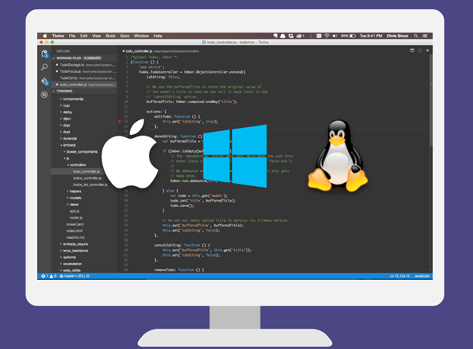

Visual Studio Code
Lightweight, cross-platform editor for Windows, OS X and Linux
Whit IntelliSense, colours, refactoring, etc.
Local editing, compilation, execution and debugging

Slide 22
Demo .NET Core

Slide 23
ASP.NET CORE

Slide 24
ASP.NET Core
ASP.NET Core is a cross-platform, high-performance, open-source framework for building modern, cloud-based, Internet- connected applications.

Slide 25


ASP.NET Core and the modern web
Totally modular
Faster development cycle
Seamless transition from on-premises to cloud
Choose your editors and tool
Open source with contributions
OSS
Cross-platform
Fast

Slide 26


ASP.NET 4.6 and ASP.NET Core
ASP.NET 4.6
ASP.NET Core
.NET Framework 4.6
.NET Core
.NET framework libraries
.NET core libraries
Compilers and runtime components (.NET Compiler Platform: Roslyn, C#, VB, F# Languages, RyuJIT, SIMD)

Slide 27
ASP.NET Core Stack
ASP.NET
Web API
MVC
Web Pages
Middleware
.NET CLR
.NET Core CLR
Host
IIS
Self-hosted
OS

Slide 28
Kestrel
Open source Web server for ASP.NET
It is fast and production ready.
It is not a fully featured web server.
It is recommended that you run it behind a more fully featured webserver like IIS on Windows or NGNIX on Linux.
It is run behind IIS using the ASP.NET Core Module (native IIS module).
Maps a HTTP Request to the HttpContext.

Slide 29
Kestrel Performance
Max of RPS Avg
3000000
2500000
2000000
1500000
1000000
500000
0
ASP.NET 4.6
ASP.NET 5
NodeJS
ASP.NET Core
Scala - Plain
Netty
IIS
WebListener
Node
Kestrel
Plain
Netty
1 - x64
1 - x86
16 - x64
16 - x86

Slide 30
Kestrel in a ASP.NET Core App
Hello world!!
Request
Kestrel
Response

Slide 31
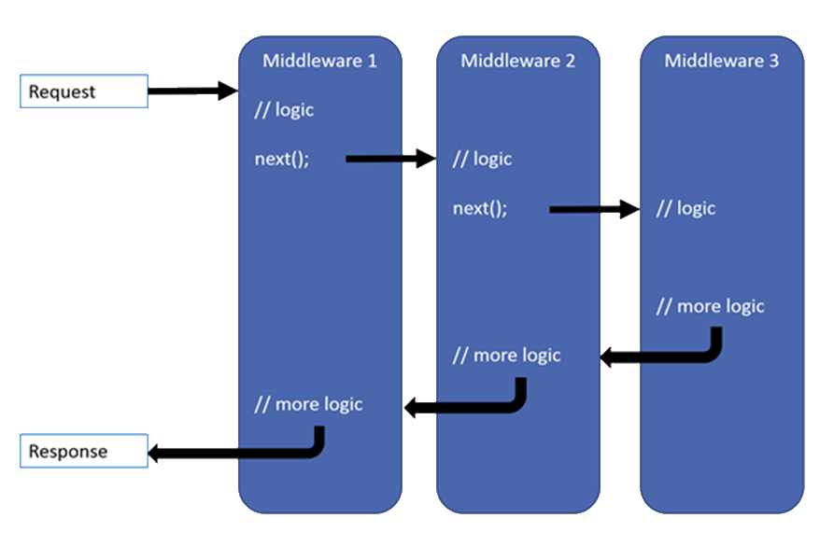
Middleware

Slide 32
Kestrel in a ASP.NET Core App
Request
Middleware
next()
Middleware
Middleware
next()
Kestrel
return
return
Response
return

Slide 33
Models, Views, and Controllers
What does MVC look like?
Request
Controller

Model

Response
View

Notes:
20486A
01: Exploring ASP.NET MVC 4

Slide 34
Web APIs
Web API
MVC App
HTML5 App
Mobile App

Slide 35
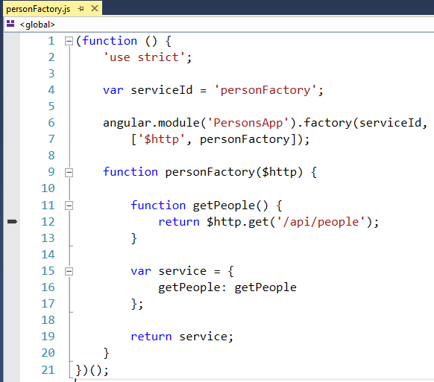
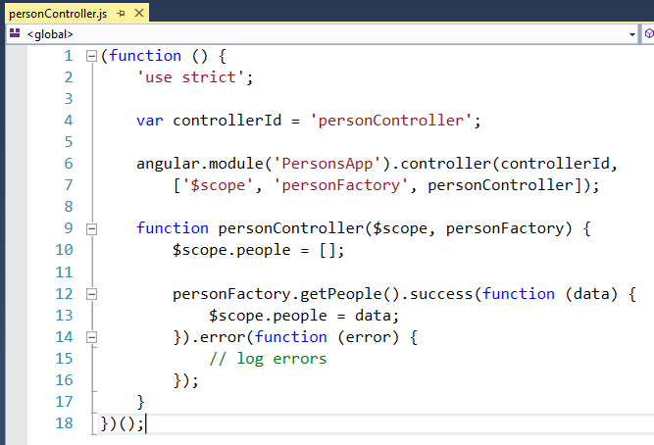
Angular App

Slide 36
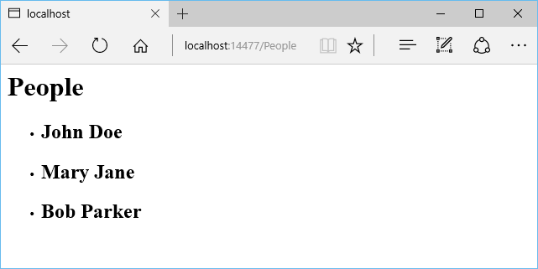
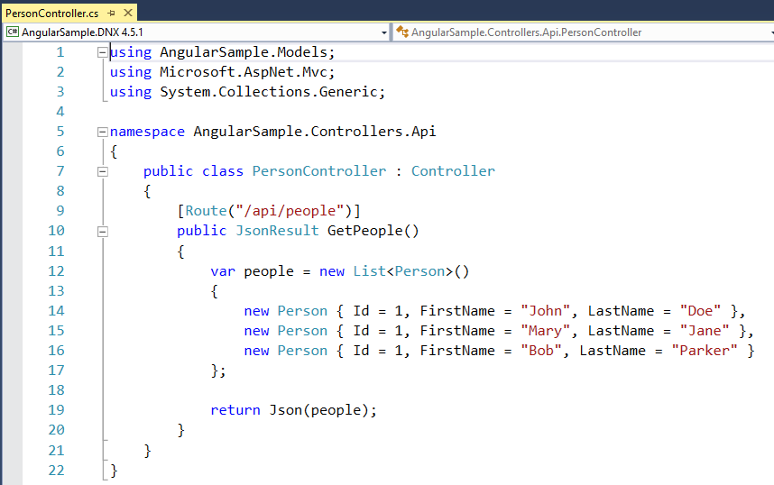
Web API Controller

Slide 37
Demo ASP.NET Core

Slide 38


Data Access
.NET Core offers providers for Data Access on different platforms:
SQL Server / Azure SQL Database
PostgreSQL
SQLite
MySQL
No changes to the data access code
ADO.NET
Entity Framework
No data migration needed
Azure SQL Database
SQL Server
In cloud
On premise

Slide 39
Deploy
Xcopy deployment
On-premises
Azure - Windows or Linux VMs
Docker container
Windows container
You can use any of the deployment technology available on the corresponding OS (Windows / Linux / OS X)
.NET Core travels with the app
A machine-level .NET installation is not required, only the runtime.

Slide 40
Going to Production
Host my app
dotnet run?
Request
Multiple Apps on one Server?
(only one port 80)
Kestrel
My Web App
And SSL?
Response
Windows authentication?

Slide 41
Going to Production
Run it with a
reverse proxy
:80/:443
:5000
IIS – nginx – apache
IIS
Kestrel
Install ASP.NET Core Module first
My Web App
nginx
Apache

Slide 42
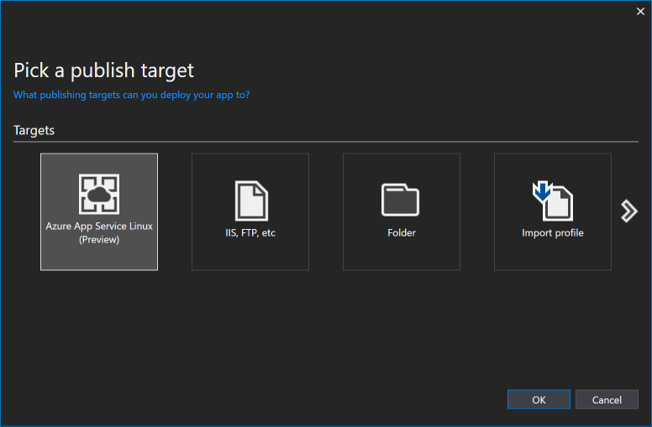
Linux VM / Docker on Azure
Deploy on Linux VM / Containers
.NET Core
ASP.NET Core

Slide 43




Docker
Docker is the most popular container technology
Azure provides supports for Docker containers
Visual Studio provides support for debugging, publishing, and managing Docker containers

Slide 44
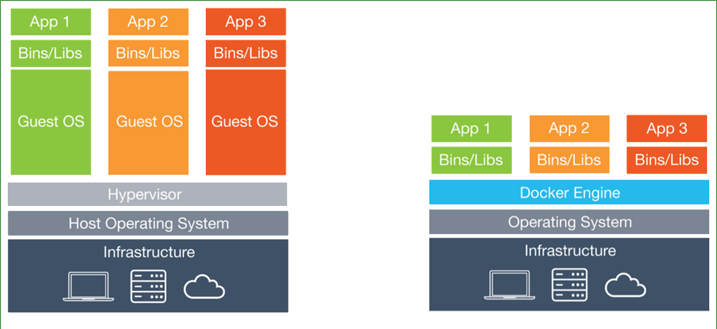
Software Containers (simplified)
A container is a "lightweight virtual machine"
Virtual Machines
Containers

Slide 45
Demo Deploy & Docker

Slide 46
Native API calls from .NET on Linux
[DllImport("libc")]
private static extern int printf(string format);
…
printf("Hello, World\n");
// Same as Platform Invoke for Windows

Slide 47
.NET
.NET FRAMEWORK
.NET CORE
XAMARIN
WPF
Windows Forms
UWP
iOS
Android
ASP.NET
ASP.NET Core
OS X
.NET STANDARD LIBRARY
One library to rule them all
COMMON INFRASTRUCTURE
Compilers
Languages
Runtime components
Notes:
Notes: Please welcome the .NET Standard Library [explain details]
As we move into the future we want to make it much easier for .NET developers to write their code once and be able to execute across .NET implementations, whether that’s .NET Framework, .NET Core, or Mono/Xamarin. To this end, we will continue to evolve and expand the .NET Standard into a set of APIs that are shared broadly across frameworks and application models. This will provide our ecosystem with much more explosive growth with libraries that can shared much more easily.

Slide 48
¿Preguntas?

Slide 49
¡ Gracias!
Mariano Sánchez
sanchezmariano@outlook.com @marianosz
http://weblogs.asp.net/marianos

